Slide 1

Cars4U Dataset
Anisah Inua Mohammed

Slide 2
Objective
Explore and visualize the dataset.
Build a linear regression model to predict the prices of used cars.
Generate a set of insights and recommendations that will help the business.

Slide 3
Data Information
Data Dictionary
S.No. : Serial Number
Name : Name of the car which includes Brand name and Model name
Location : The location in which the car is being sold or is available for purchase Cities
Year : Manufacturing year of the car
Kilometers_driven : The total kilometers driven in the car by the previous owner(s) in KM.
Fuel_Type : The type of fuel used by the car. (Petrol, Diesel, Electric, CNG, LPG)
Transmission : The type of transmission used by the car. (Automatic / Manual)
Owner : Type of ownership
Mileage : The standard mileage offered by the car company in kmpl or km/kg
Engine : The displacement volume of the engine in CC.
Power : The maximum power of the engine in bhp.
Seats : The number of seats in the car.
New_Price : The price of a new car of the same model in INR Lakhs.(1 Lakh = 100, 000)
Price : The price of the used car in INR Lakhs (1 Lakh = 100, 000)

Slide 4
Note:
There are missing values in this dataset
There are null values in this dataset
There are outliers in the dataset
In this dataset here are 7253 rows and 13 columns.
Dataset contains 6019 unique values and 13 features

Slide 5
Categorical Data Types
•Brand
•Model Year
•Owner Type
•Transmission

Slide 6
Continuous Data types
•Power
•Engine
•Kilometers_Driven
•New_Price

Slide 7
Problem Statement
Currently if anyone wants to sell their car either they have to take their car to a respective company workshops or have to make appointment for company to get an estimate of the price.This Process involves a lot of time and resources.Our Objective is to make a model for third party companies which will make a estimate of the Price of the customer’s car directly from their online portal. This will save customer’s time and help the company to reduce its cost and also streamline the process of selling used cars.
To Achieve this objective we wanted to do an Exploratory Data Analysis on our dataset to understand the relationship between the price of the car and other features of a car.

Slide 8
Exploratory Data Analysis

Slide 9
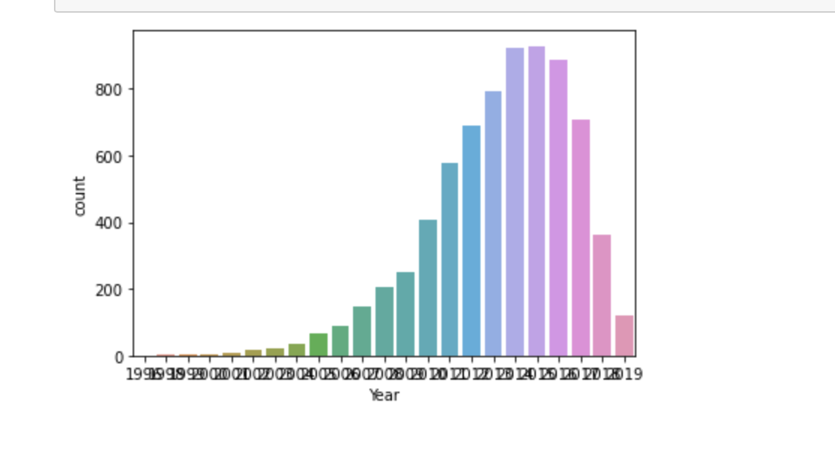
Year
Observation
this graph is left skewed which explain that we have very few cars which are from 1996-2001
Most of the cars are from the years 2007-2019
The higheest number of cars are from the year 2015

Slide 10
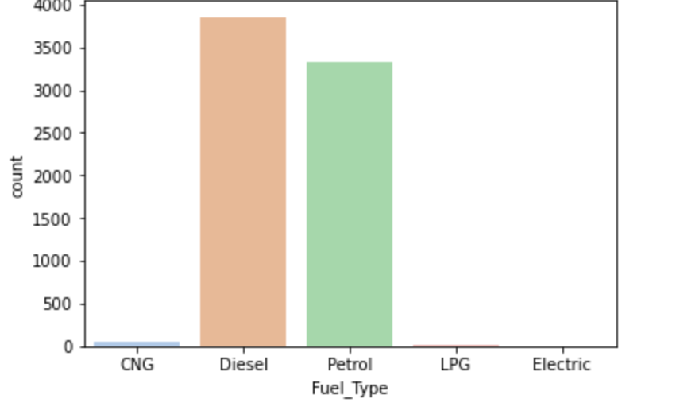
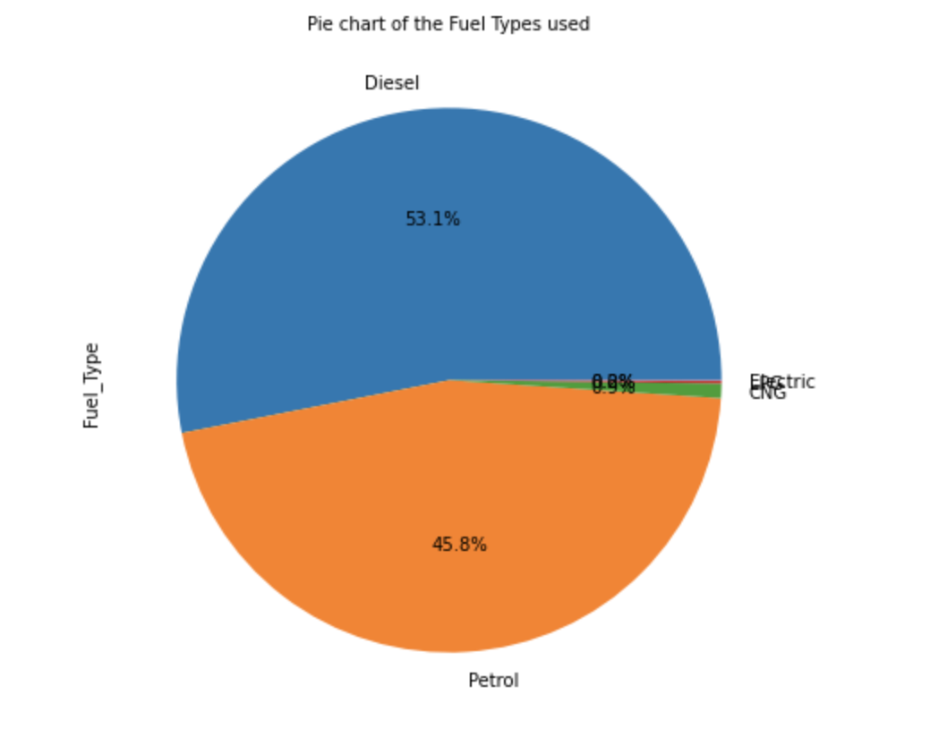
Fuel_Type
Observation:
This shows the following:
Over 50% of the cars use Diesel as their fuel type
A lot of cars also use Petrol but not as much as diesel
Very few cars make use of CNG as their fuel type
There are hardly any cars that use LPG or any electric cars

Slide 11
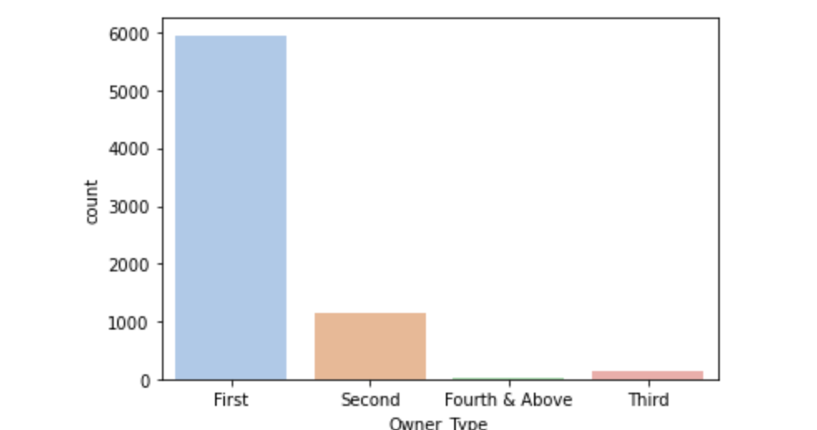
Owner_Type
Most cars have only had one ownership before
Some cars have had second and third ownership
Very few cars had forth and above ownership

Slide 12
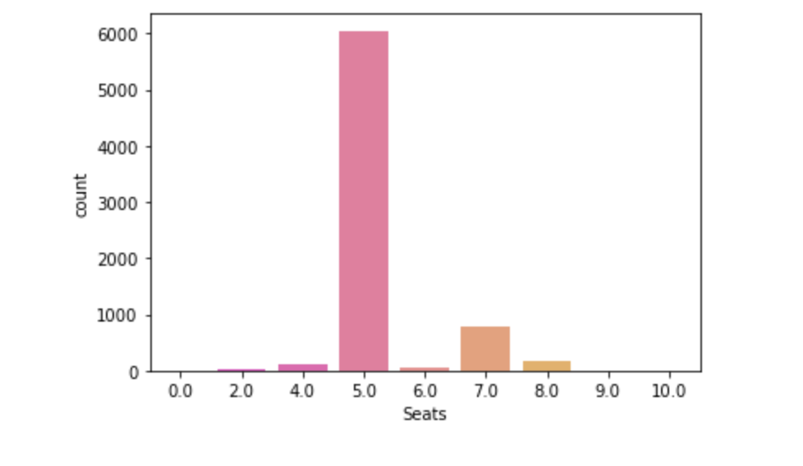
Seats
Over 6000 cars are 5-Seaters
Most cars are cars are 5-seaters
There is also a good number of cars which are 7 and 8 seaters
This could mean that the cars in the dataset could be quite big and spacious
There were hardly any cars with 9 or 10 seats in them

Slide 13
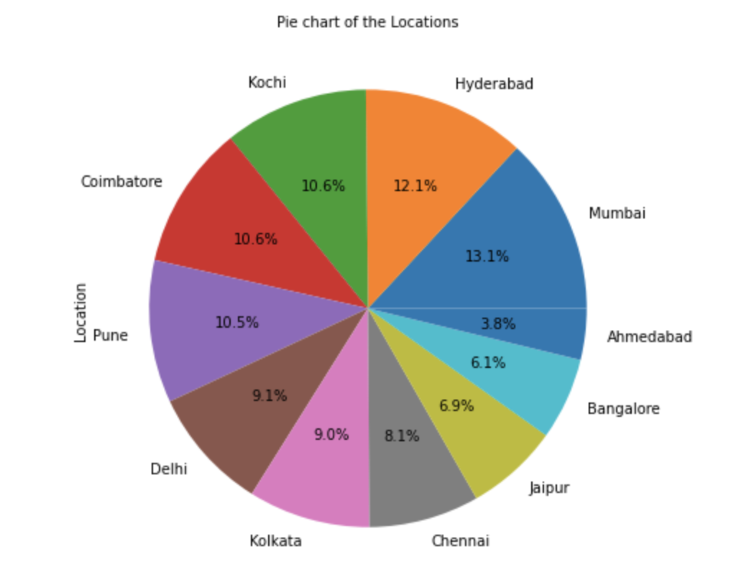
Location
A lot of cities were almost used equally in the locations for the cars
The highest amount of cars that are being purchased or available is in Mumbai.
The least location if where the cars are available or being purcahsed is in Ahmedabad.

Slide 14
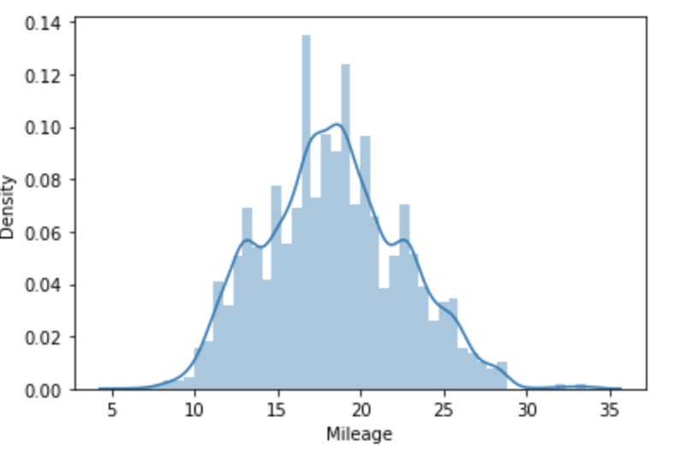
Mileage
The graph above shows that Mileage can be normally distributed
Mileage spread is not giving any linear relationship.

Slide 15
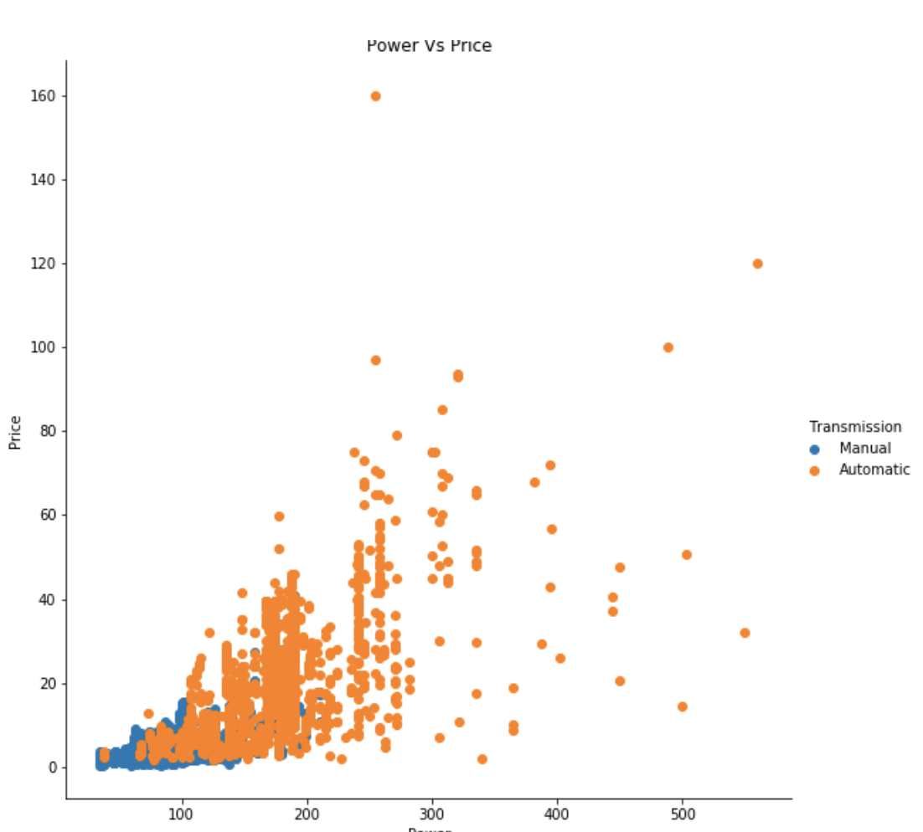
Power
Power has high correlation linear with price and above 300 HP only automatic cars there.

Slide 16
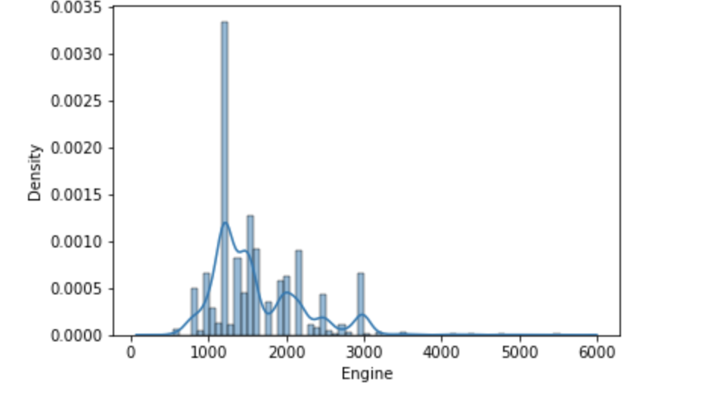
Engine
Engine also has high correlation linear with price and above 3000 cc only automatic cars there. So, let’s see engine and power correlation also if they both are also highly correlated
As, we can see engine and power are highly correlated which can cause multi collinearity. While moving to model building we have to do test for multi collinearity and remove one of them if they are dependent on each other to apply linear regression model.

Slide 17
Engine
This reveals that the the Engines are rightly skewed when the long tail is at the right side which explains that the mean is greater than the median (mean>median).
Also the displacement volume of the engines are under the range from -500-10000

Slide 18
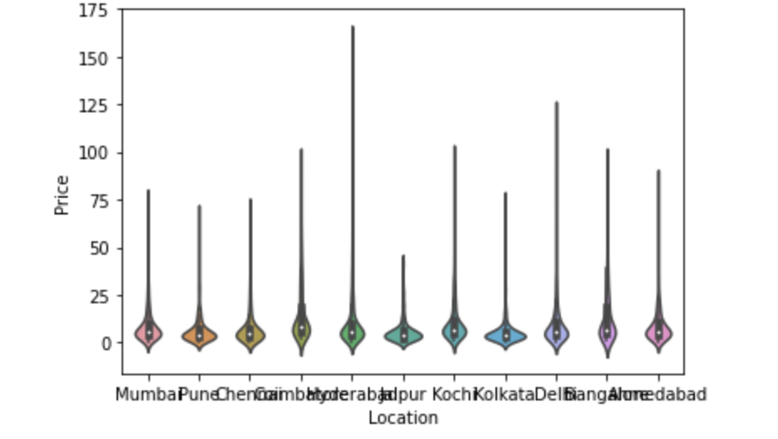
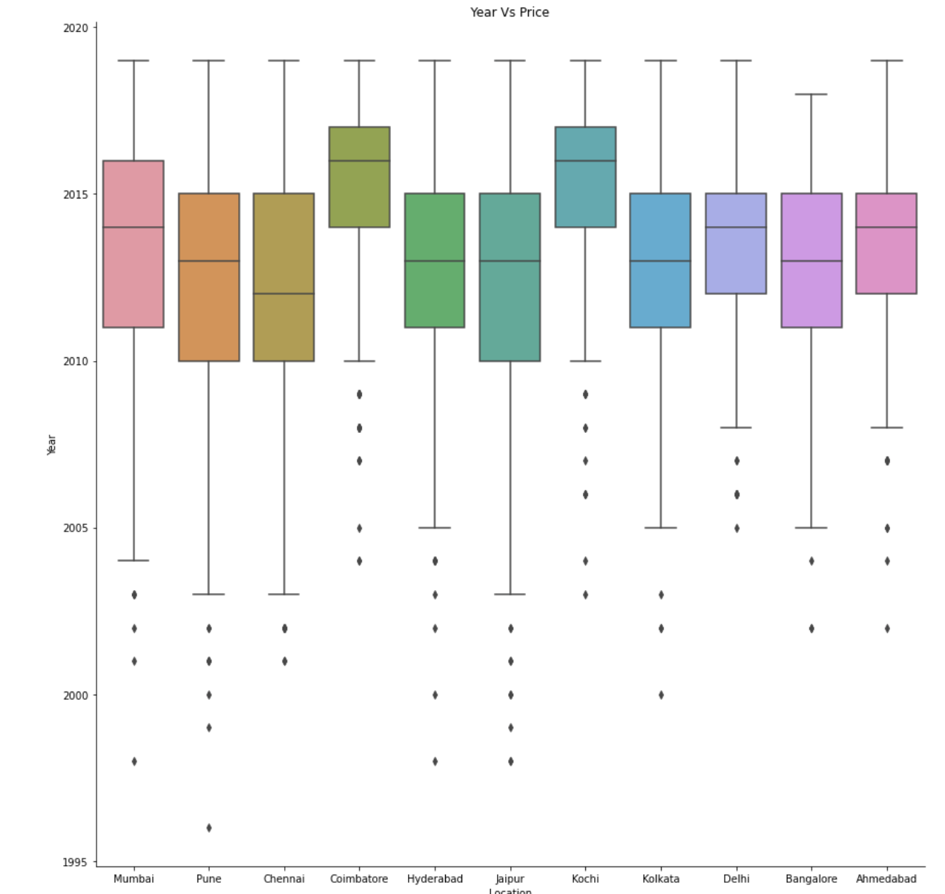
Year, Price and Location
The above box plot shows that there is almost an equal spread. However, in Coimbatore and Bangalore their median value is lower than others but there is no signifanct effect so it would not really be a major feature.
This also means that a high spread can be because of more number of higher ranges car in the dataset.

Slide 19
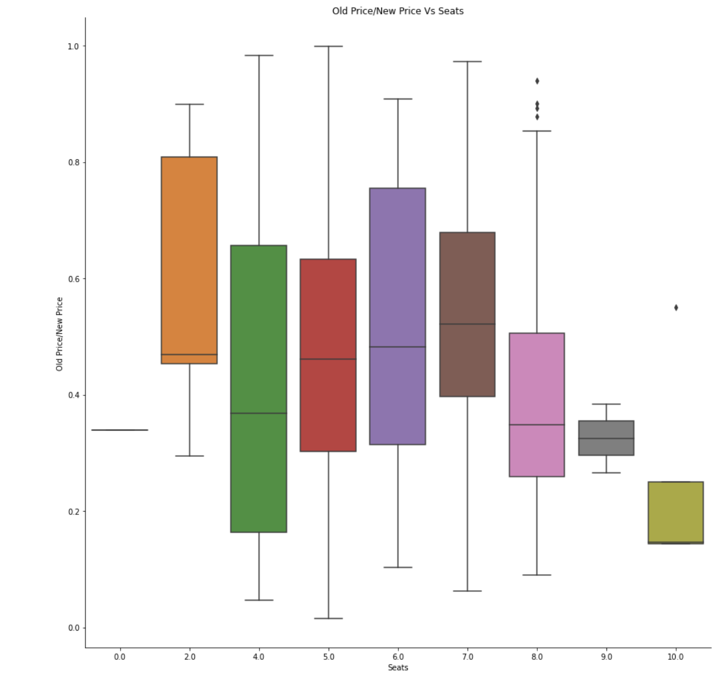
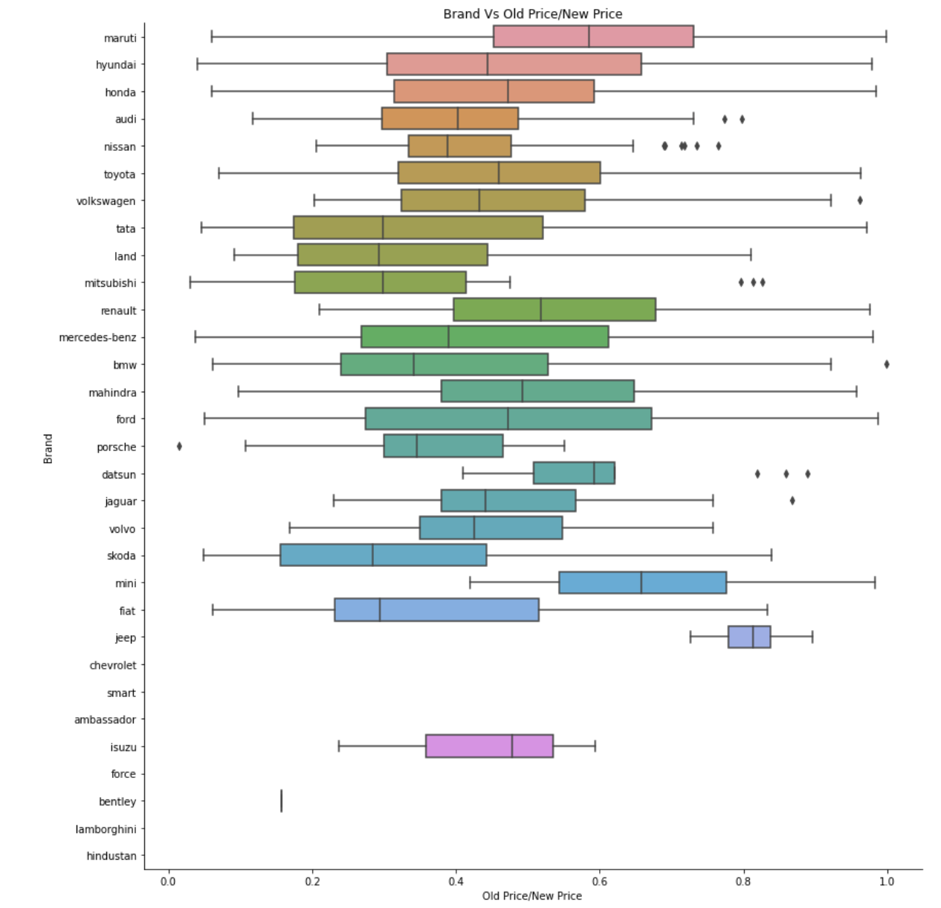
Seats, Price and Brand
Observation
The 2 and 4 seaters cars that have large spread and range is high for 2 seaters but other 5 seaters and above have same spread with lot of outliers in 5 and 7 seaters due to luxury cars. Old_Price to New_Price ratio vs Seats is also same median for 2,5,6,7 seaters around 0.5. So this factor not playing major role in price.

Slide 20
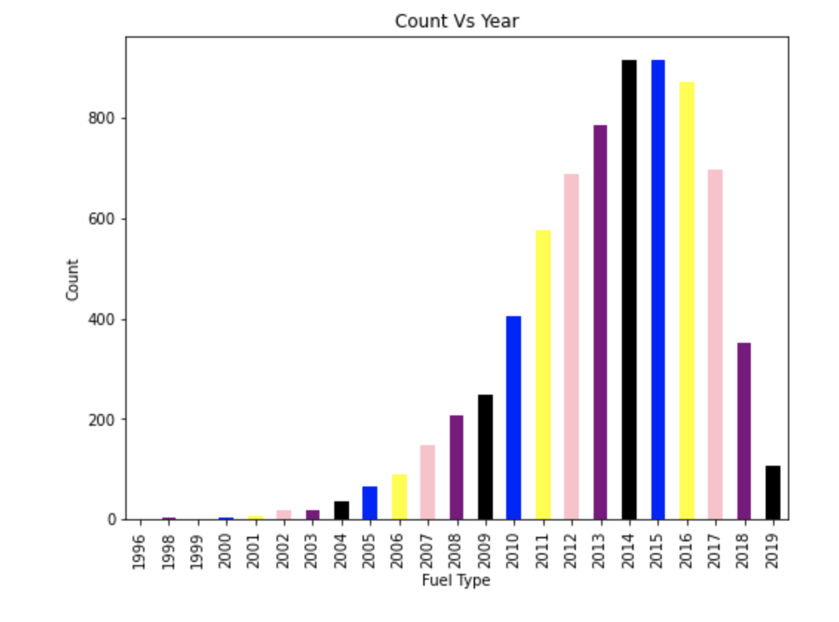
Count Vs Year with Hue of Fuel Type
This shows that in the most cars sold is for either diesel or petrol.
The diesel cars are also the highest amount of cars sold and also in most demand
The price of fuel_type was probably low in the years 2013-2017
The peak years for cars in 2014-2015

Slide 21
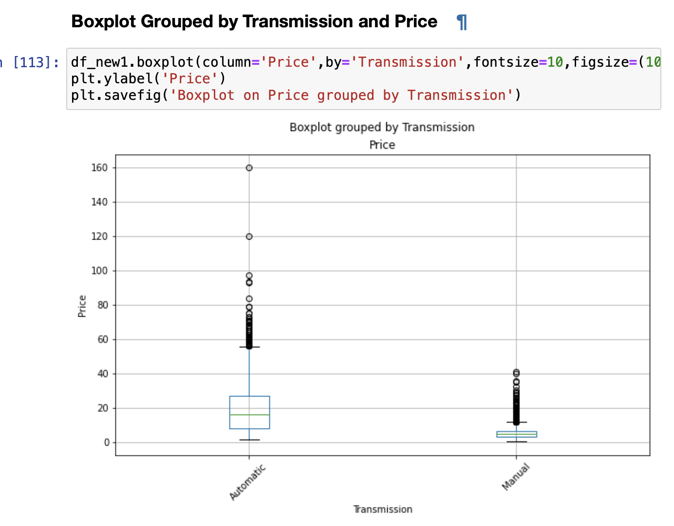
There are more manual cars in the dataset
More Outliers in automatic cars
The most amount of Manual Cars are available in Hyderabad
the most amount of automatic cras are in Mumbai
The most most cars in the dataset are automatic cars
Most of the the automatic and manual cars have an ownership type of first owner.

Slide 22
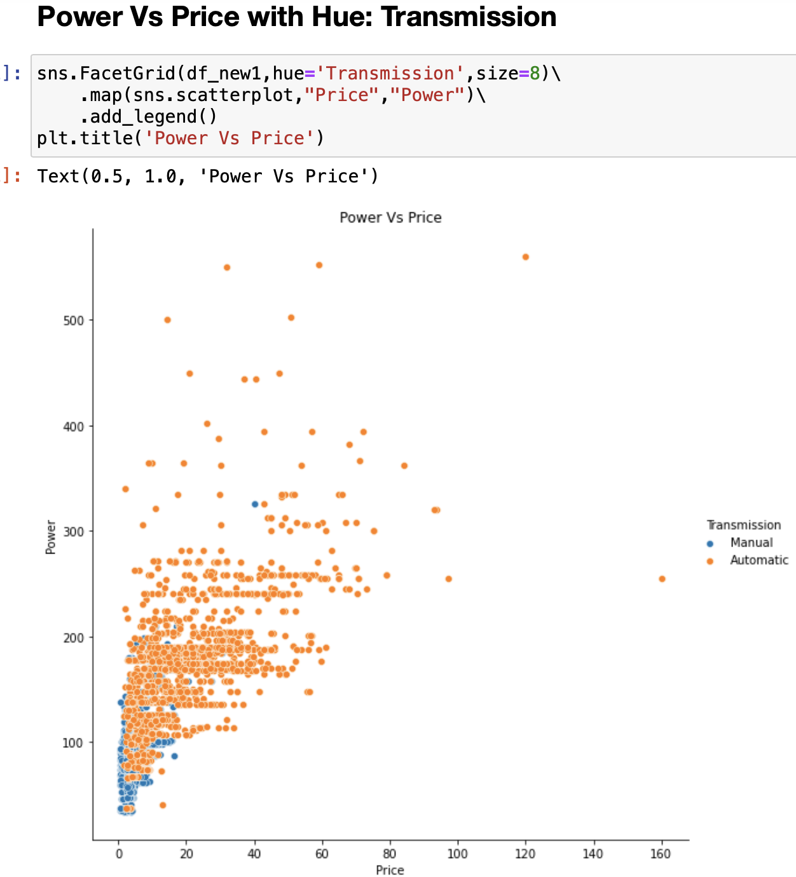
Observation: Power has high correlation linear with price and above 300 HP only automatic cars there.

Slide 23
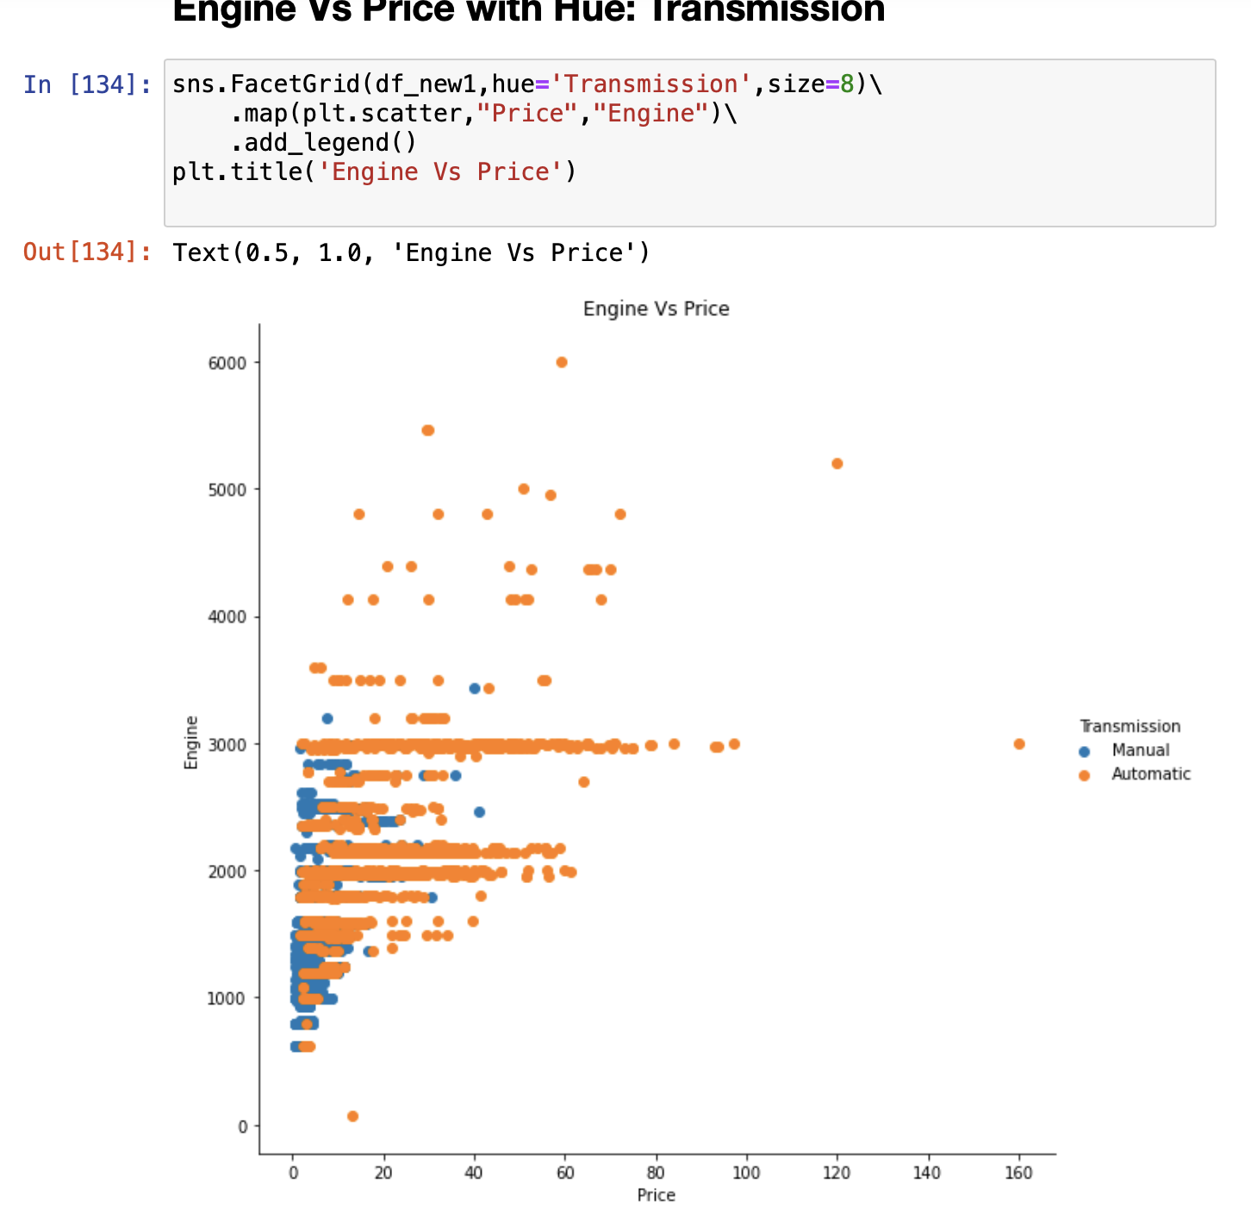
Engine also has high correlation linear with price and above 3000 cc only automatic cars there. So, let’s see engine and power correlation also if they both are also highly correlated
As, we can see engine and power are highly correlated which can cause multi collinearity. While moving to model building we have to do test for multi collinearity and remove one of them if they are dependent on each other to apply linear regression model.

Slide 24
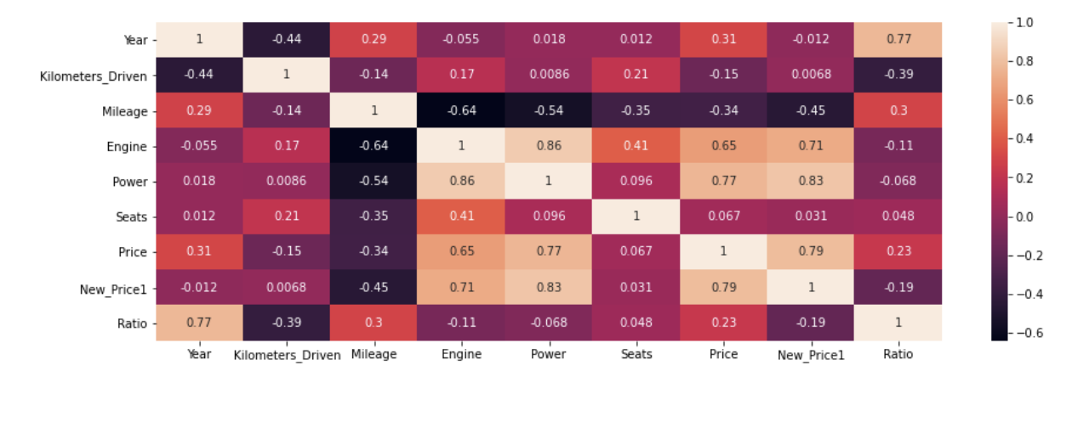
Correlation Heatmap of Numerical Data

Slide 25
Conclusion
So, by above univariate and bivariate analysis we can see below features are playing important role in deciding resale price of car which we can use in for our model building.
Name has the highest amount of unique values followed by New_price while Location, Fuel_type, Transmisson ND OWNER_TYPE also include unique values.
Location has 11 unique values thismeans that the data was collected from 11 different locations in india.
The year of the used cars started from 2011 to 2019
The average amount of kilometers driven by a car is 53,416km
The most frequent fuel_type used by these cars is diesel
Most of the used cars in the dataset are manual cars.
The average seats in the cars in this dataframe are 5 seats
The average price of the car is 9.479 Lakhs
Since New_price has alot of missing values we might decide to drop it while further analysing this dataset
We would also be converting Mileage, Engine and Power into numerical data

